Slide 1
SE 577 Software Architecture Cloud Native Architectures

Slide 2
What are cloud native architectures?
Cloud native architectures interestingly have nothing directly to do with the cloud, although to realize its goals, they tend to utilize cloud-based platforms
Attributes of cloud native architectures
Support rapid and continuous deployment
Elastic Scale (both up and down)
Embrace automation for everything – think “x as code” – infrastructure provisioning, build processes, deployment
Are “supervised” to promote fault tolerance and self-healing
Pay for what you use vs pay for software licenses
Shift engineering attention towards building solutions vs managing infrastructure, security patching, updating/upgrading and configuration
Are “antifragile” – as we increase stress on the system via speed and scale the system improves its ability to respond
Are API first, every aspect of the system can be managed via APIs

Slide 3
What are cloud native architectures?
What is needed for a cloud native architecture given the fact that they don’t actually have to run in the cloud?
Regardless of on prem, or public cloud, all cloud native architectures require
Software defined control of technical resources that support, compute, network, security policy and storage
APIs that allow engineering to control every aspect of infrastructure configuration and deployment
An underlying platform that provides isolation and redundancy of workloads
An underlying platform that is hardened against any single point of failure
An underlying platform that can apply course- and fine-grained security everywhere
An underlying platform that is polyglot – allows workloads to be developed in any language on any platform
An underlying platform that supports granular collection of data to support billing (direct, internal chargeback) based on resources consumed
The above list is basically best served by a mainstream cloud provider – AWS, Azure, GCP, etc; however you can also do these things to a large degree on premise – example, VMWare has a number of these offerings, and many cloud providers provide virtual machines that you can run on premise to take the end of the cloud on prem.

Slide 4
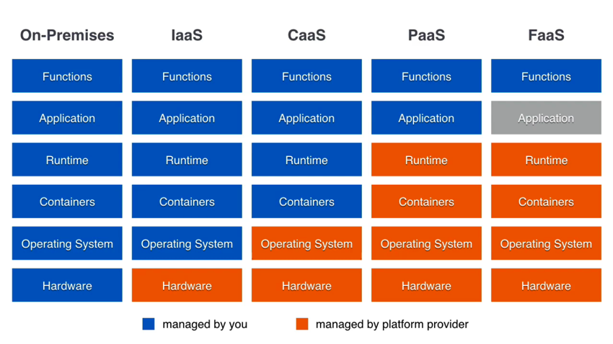
Cloud Computing Models

Slide 5
Cloud Computing Models
Increasing Preference – moved towards fully managed wherever possible
Weeks Minutes Seconds Sub-Second Micro-Second
Reaction Time to Change

Slide 6
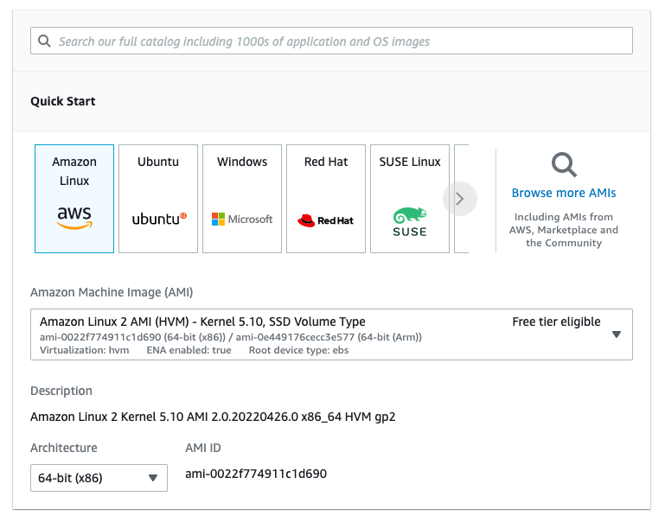
IaaS Example – Aws EC2
AWS EC2 allows you to launch a virtual machine inside of a “virtual data center” – VPC
Startup time = a few minutes

Slide 7

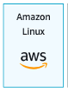
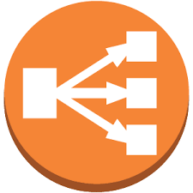
IaaS Example – Aws EC2
When you provision a virtual machine, you can specify a “startup script” to install and configure your instance
You can also take a bare instance, ssh into it, configure it, and then create your own custom AMI (Amazon Machine Image) – like a docker image but for a full virtual machine
You can setup an elastic load balancer (a fully managed service) to send traffic to EC2 instances, they can also run health checks to scale them
The biggest drawback with IaaS based solutions is that you are responsible for everything including patching the OS, software installation and configuration, and defining how the virtual machines will be managed, scaled, etc. Also, scaling EC2 is slow, takes several minutes since its an entire VM reboot

Slide 8
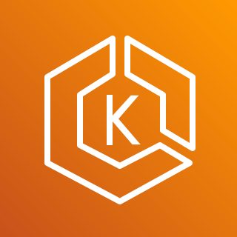


CaaS Example – Aws ECS
CaaS solutions require you to manage fewer things, you just manage your container images, the cloud provider manages the runtime (data plane) that executes the containers
EKS Elastic Kubernetes Service
ECR Elastic Container Registry
You are still responsible for things like patching and upgrading containers (base images, dependencies)
ECS Elastic Container Service
In this example EKS and ECS are both fully managed services, the architecture tradeoff is a standards based solution EKS, which is more difficult to manage vs ECS which is cloud specific to AWS

Slide 9
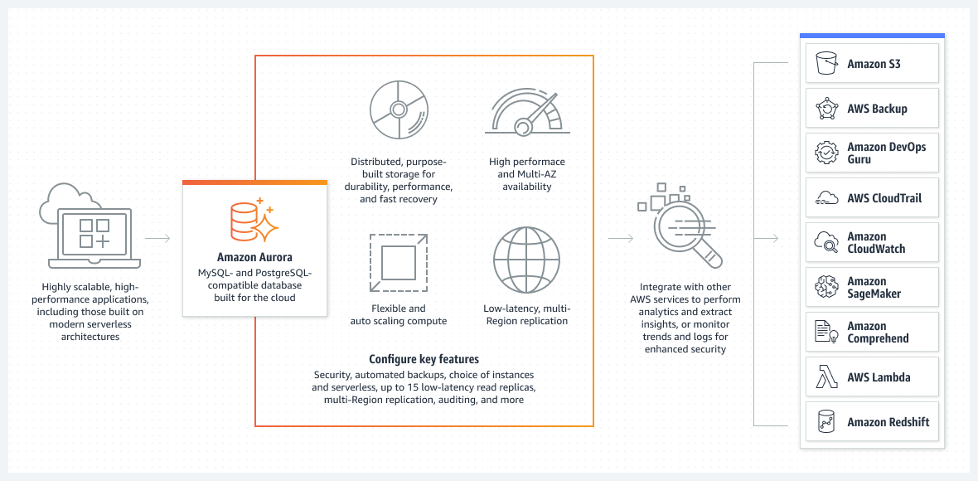
Fully Managed Service Example
Amazon Aurora provides built-in security, continuous backups, serverless compute, up to 15 read replicas, automated multi-Region replication, and integrations with other AWS services.

Slide 10
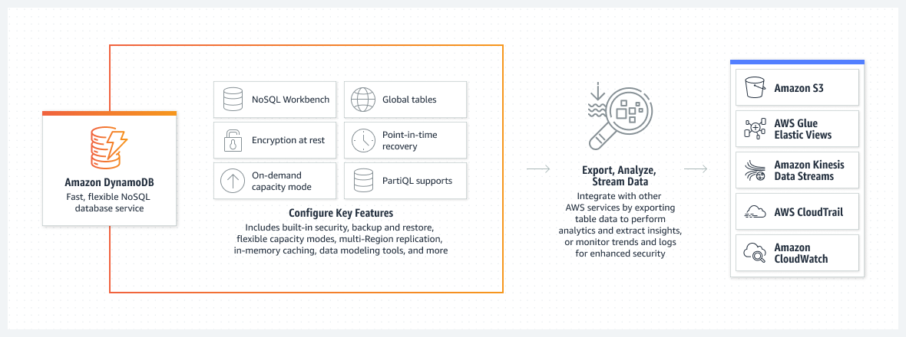
Fully Managed Service Example II
Amazon DynamoDB is a fully managed, serverless, key-value NoSQL database designed to run high-performance applications at any scale. DynamoDB offers built-in security, continuous backups, automated multi-Region replication, in-memory caching, and data export tools.
Of architectural interest, is that fully managed distributed database services look more like microservices than they do typical databases

Slide 11
FaaS – AWS Lambda
To best understand lambda, lets take a step back to look at the docker architecture to build containers
docker build -t architecting-software/se577-bc-go -f Dockerfile .
Docker Container
Create Ephemeral Writable Layer
API Container
Instruction to Run Executable
Copy Executable
New bare Alpine based OS Image
Temporary Build Container
Build executable
Copy source code into container
Alpine-Based OS with Go installed
You can then run the code in the container
docker run –p 9095 architecting-software/se577-bc-go
This is a bit of work, what if you could just say “here is my code”, go run it? That’s what AWS Lambda is about

Slide 12
FaaS – AWS Lambda
AWS Lambda
Lambda Config
Upstream Event
Downstream Event
Lambda Security Policy
Lambda Code {
…
}
Lambdas run your code based on an upstream event (e.g., API Request, File Upload, IoT Event, etc), and can optionally trigger downstream events (e.g., send an SMS message)
Lambdas must have really fast startup times to run your code at essentially infinite scale

Slide 13
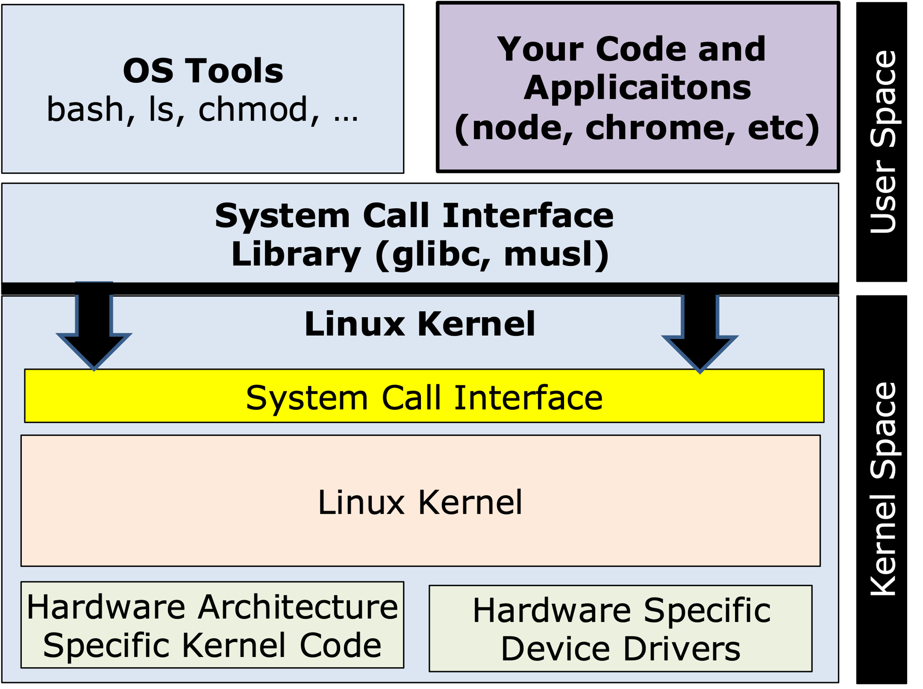
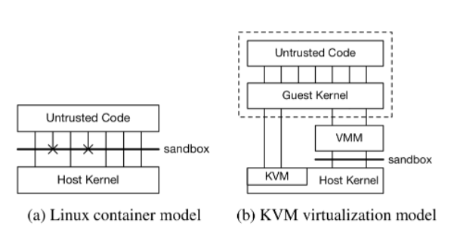
FaaS – AWS Lambda Architecture
Why do we need lambda if we have containers, they start fast after all?
Remember the container architecture, its very fast, but each container is visible to the host machine as a stand alone process and the containers share the host machine’s kernel
From the firecracker paper we see some of the potential security challenges of just using linux containers, a way to better isolate workloads is the KVM virtualization model on the left

Slide 14
FaaS – AWS Lambda Architecture
Why do we need lambda if we have containers, they start fast after all?
Equivalent to a container, but much more secure since they don’t ride directly on the guest OS
Virtual Machine Managers tend to be large and complex pieces of software, and thus have slow startup times

Slide 15
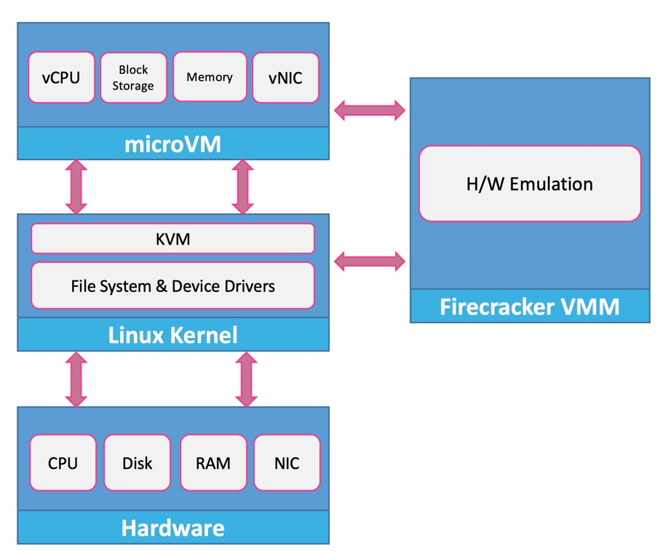
FaaS – AWS Lambda Architecture
Why did I assign the firecracker paper?
Firecracker is a highly optimized VMM along with a Micro VM that is designed from the ground up to support serverless workloads.
Micro VM
Firecracker VMM

Slide 16
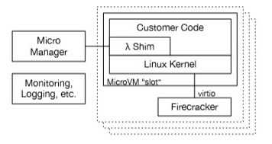
FaaS – AWS Lambda Architecture
Lambda code is here
RESTful control plane
Essentially the packaged Lambda container
Attachment/Detachment point to microVM
Firecracker has been tested and proven via billions of lambda serverless executions and fargate container invocations
Startup time is about 100ms Density is about 4000 instances per host

Slide 17
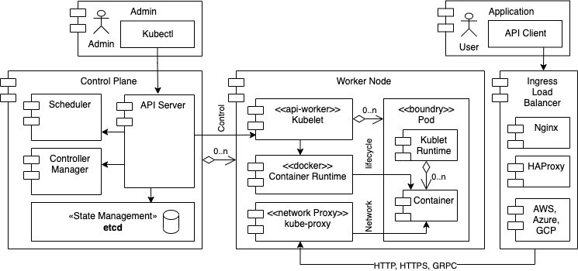
Caas/FaaS Hybird – AWS Fargate
Scheduler
K8s Scheduler augmented with a fargate scheduler
MicroVM Slot
Fargate Scheduler
Pod
Customer Containers
Default Scheduler
Customer Containers
Customer Containers
Fargate optimized Node Services (e.g, Kubelet, Kube-Proxy
Linux Kernel
Firecracker VMM
Fargate nodes preallocated and spun up to act like a dynamic worker node, the pods are basically started serverless
Recall, the Kubernetes architecture has predefined nodes spun up, where each node runs one or more workloads via pods. Generally, nodes have a preconfigured number of pods that they start and can scale up and down from there. Scaling pods generally takes in the order of seconds with the default scheduler, microseconds with fargate and firecracker

Slide 18
Back to Cloud Native
Now that we have a good handle on different types of workloads in cloud native architectures
Some other things to consider
Managing cloud resources and application assets via automation – gitops
12 factor apps and architectural considerations for software design of cloud native apps
Best practices based on learnings over the years – example, AWS Well architected framework

Slide 19
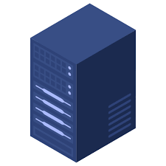
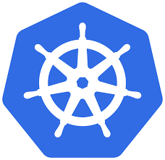
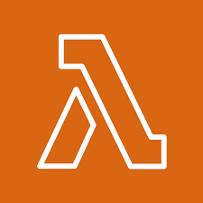

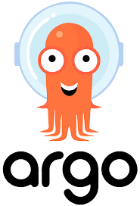


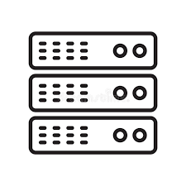

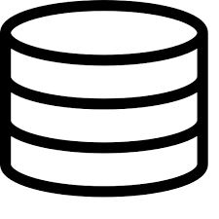
GitOps – Best practices for automation of cloud native workloads
GitOps is about putting git in the center of managing the CI/CD process. Git maintains the desired state, and CI/CD tools such as argo and tekton leverage Kubernetes to figure out how to transition the current state into the desired state
Applications
Desired State
Kubernetes Orchestrator
Deploy
watch
Code Manifests Config
state
Infrastructure
Kubernetes used to power figuring out desired state from current state

Slide 20
Moving from Scale-Up to Scale-Out architectures
One of the biggest considerations for architectures that support cloud native computing concepts is to favor scale-out over scale-up. If your architecture cannot support scale-out, it is not really aligned with cloud native computing concepts. WARNING WARNING WARNING Scale-out takes you into the realm of needing to be very good at distributed computing

Slide 21
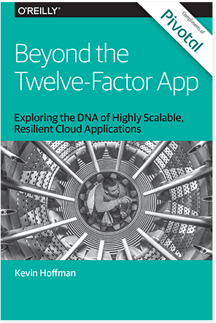
Design and Architecture best practices that have created the foundation for cloud native
12 software design practices proposed by Herouku (https://www.heroku.com/) for building modern scalable apps – Published 2011
In 2016, these concepts were updated with 15 practices by Pivotal

Slide 22
Architectural best practices for modern applications
One codebase, one application
API first
Dependency management
Design, build, release, and run
Configuration, credentials, and code
Logs
Disposability
Backing services
Environment parity
Administrative processes
Port binding
Stateless processes
Concurrency
Telemetry
Authentication and authorization
These practices apply towards modern distributed apps – web, mobile, cloud, IoT

Slide 23
1. One Codebase
A codebase for an application is used to create any number of immutable releases that are likely destined for different environments

Slide 24
2. API First
Service
API
Service
API
API
API
Service
Service
All externally visible application interfaces are exposed via well-defined APIs. Define the API-interfaces first for clients and other services

Slide 25
3. Dependency Management
Your Code
Build Process
Dependencies
Runnable Application
Never rely on the existence of system-wide dependencies. Explicitly declare all dependencies (and versions) pulling them in dynamically at build time (maven, sbt, npm, yarn, go, cargo, etc)

Slide 26
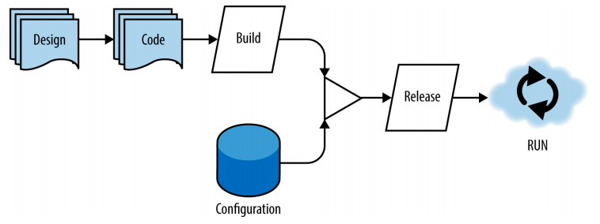
4. Design, Build, Release and Run
Every release is coordinated via an automated build process that injects the proper runtime configuration. Supports a CI/CD pipeline. This is at the center of the gitops based patterns

Slide 27
5. Configuration, Credentials and Code
Configuration
Runtime Container
Database
Runtime Environment
Security Credentials
Deploy Process
Hostnames
Running Code
Runnable Code
Treat configuration as code – configuration is everything likely to change between deploys. Ideally deployment configuration changes are injected into the runtime as environment variables. Again, we see this in gitops

Slide 28
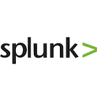
6. Logs
Runtime Container
Log Aggregation
Utility
Utility
EVENT
App
LOG
LISTEN
LISTEN
LOG STREAM
Runtime Container
LISTEN
LISTEN
EVENT
App
LOG
Utility
Utility
Logs provide insight into the behavior of a running app. Logs should be considered as an event stream, capturing all events from a system in a time ordered sequence. Each app instance is only concerned writing locally to its log, aggregation and streaming are handled outside of the application runtime. All modern public cloud offerings support these capabilities intrinsically, and third party solutions that aggregate logs are very powerful (e.g., splunk)

Slide 29
7. Disposability
“Pets vs Cattle”
Application instances should be able to be started quickly, and terminate cleanly. Repair is never done, instances are disposed and replaced. Favor light/thin frameworks over heavy/fat middleware. This is the key enabler towards scaling out versus scaling up. EVERYTHING SHOULD BE EPHEMERAL in cloud native architectures.

Slide 30
7. Backing Services
Treat backing services as attached resources. They are attached via a URL or other location and and security credentials managed by the config. Resources should be able to be attached and detached to the application on demand without any code changes.

Slide 31
9. Environment Parity
Time
Becomes more important as the check-in to deployment cycle time decreases. Days? Months? Minutes
People
Specialized Skillsets, or “if you build it, you deploy and run it”
Resources
Expensive, specialized resources (Oracle DB), or general purpose open source (Postgress)
Keep all environments as similar as possible. Need to avoid ”it works on my machine” scenario. Might be impossible to totally maintain consistency, but it should be maximized as much as possible. Can be mitigated with other factors such as Backing Services, Configuration as Code, etc

Slide 32
10. Administrative Processes
Runtime Container
Application Code
Timed or scheduled activities (Backups)
Application User
Administration Code
Administrator at Terminal (REPL)
Run administrative and management tasks as one-off processes. Admin code should be managed and deployed with the underlying application code. Admin actions should execute in the same runtime configuration as the underlying application

Slide 33
11. Port Binding
Service Discovery
Runtime Container
Runtime Environment
(Config)
Advertise
Discover
Running Code
Bootstrap
To Port
Discover
Export services via port binding. Use a service discovery mechanism to locate and bind to other services. Examples, ETCD and Consul – basically a highly dynamic DNS service. In AWS, all resources can be discovered by ARN, also many managed services provide these capabilities.

Slide 34
12. Stateless Processes
Runtime Container
Backing Services for State
Application Code
Database
Application User
Distributed Cache
Services should be “share nothing” and stateless. Any state or persistence operations should be handled in a backing service such as a cache or database. This is a key attribute of resiliency and scale

Slide 35
13. Concurrency
Scale out via the process model. Dynamically be able to start and stop various aspects of your application based on load or needs. This is different from a scale-up model where scaling involves increasing all services equally.

Slide 36
14. Telemetry
Runtime Container
INSTRUMENTATION STREAM
Runtime Environment
(Config)
Telemetry Data
Running Code
LISTEN
LISTEN
Application Code
ALERTS
Admin Console
Rules Engine
Slack, SMS, etc
Built-In Instrumentation
All well designed application have built in instrumentation to communicate on application health (e.g., performance, errors, resources, etc). Examples, AWS Cloud Watch, Dynatrace, New Relic

Slide 37
15. Authentication and Authorization
Runtime Container
Runtime Container
Application Code
Application Code
Application User
Security Enforcement Point
Security Enforcement Point
Every request to your application should know about who (person or service) who is making the request and the roles that they have that dictate access. See OIDC and oAuth as examples. AWS handles this via security groups, network NACL, and a variety of other policy based services in IAM

Slide 38
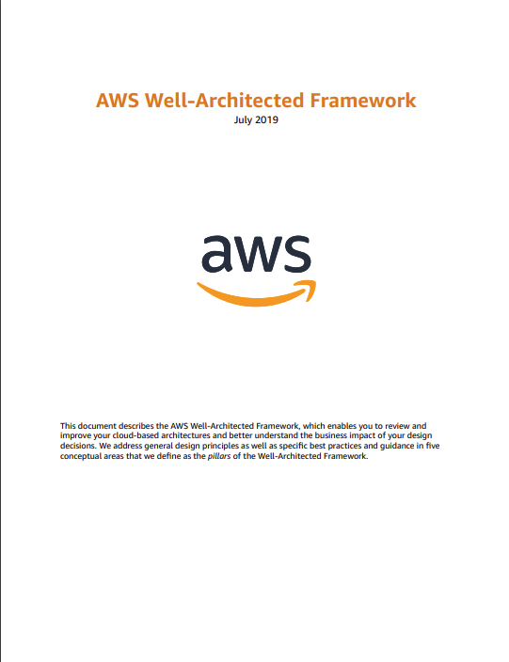
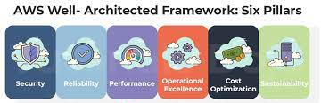
Well Architected – Cloud Native – Example AWS Well Architected Framework
https://aws.amazon.com/architecture/well-architected

